Slide 1
intro

Slide 2
What we chose
We chose the provided case study for the team project which was to create a software for an on-line supermarket.
The requirement of the case study is to produce a software that meets the four cores, which include loyalty scheme, payment, marketing and supplier interface.
The group is made up five so we produced an additional core which is analytics, which is simply an analysis of the software's performance.

Slide 3
Meet The Team
Akber – Project Manager / Supplier
Sabaa – Head Core Developer/ Analytics
Abdala - Marketing
David – Payment
Subodh – Loyalty Scheme

Slide 4
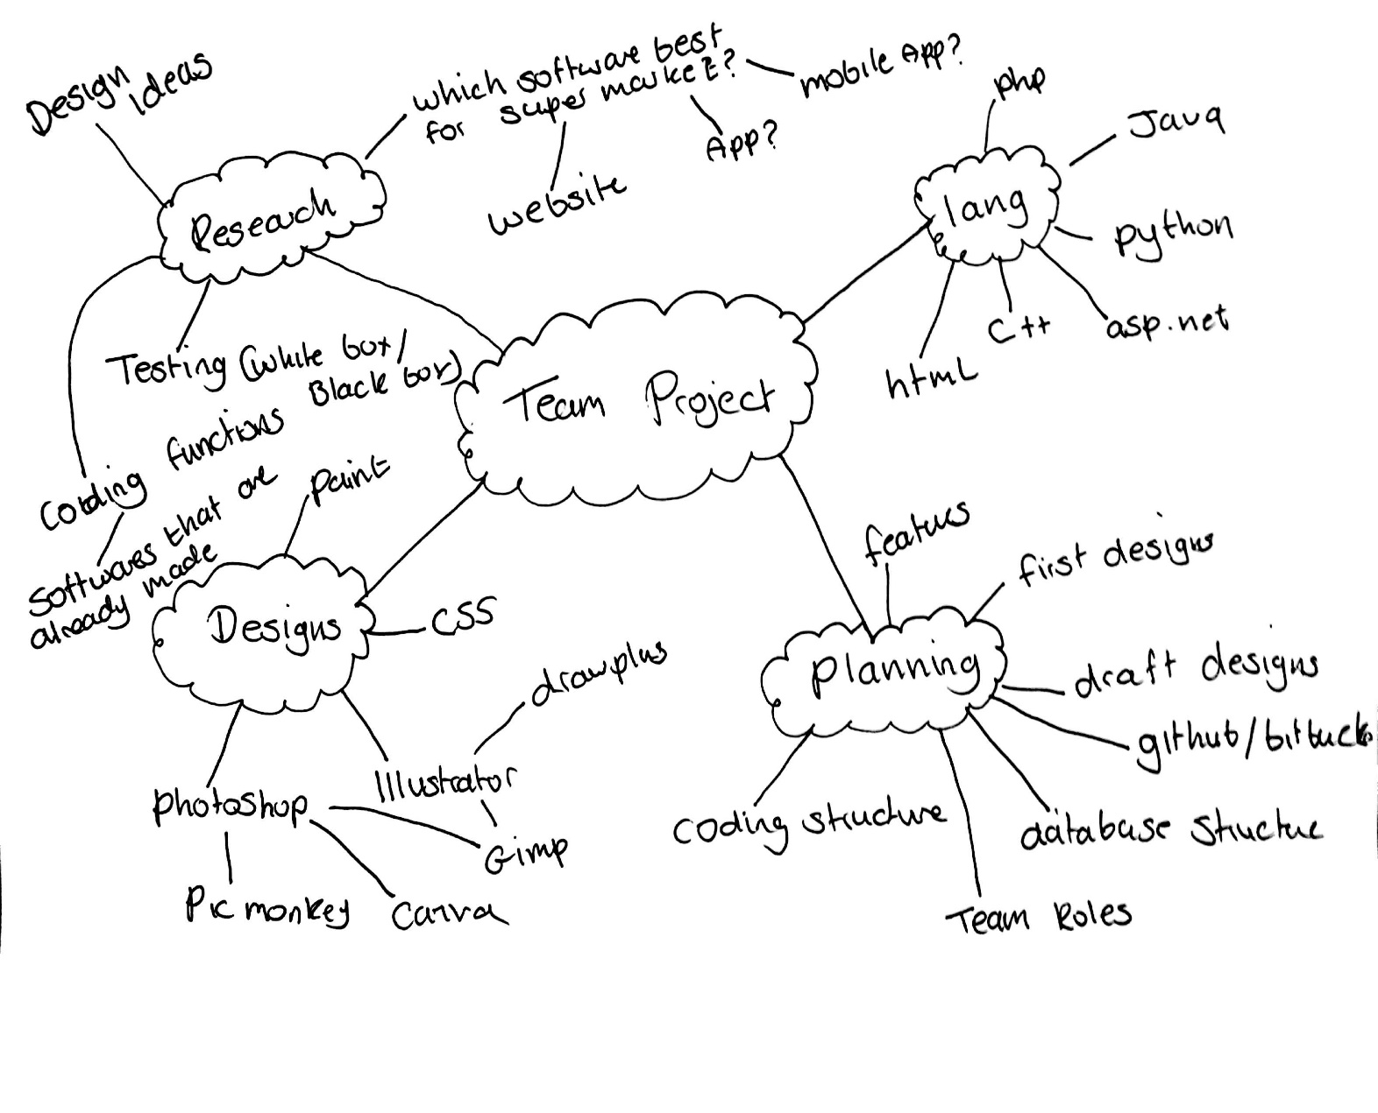
Planning
The course of action we took towards the planning of the project was brain storming.
This was basic but effective as it encouraged group members to provide their ideas and perspective on the project.

Slide 5
Content Management System (CMS)
A web content management system (WCM or WCMS) is a CMS designed to support the management of the content of Web pages. Most popular CMSs are also WCMSs. Web content includes text and embedded graphics, photos, video, audio, maps, and program code (e.g., for applications) that displays content or interacts with the user.

Slide 6
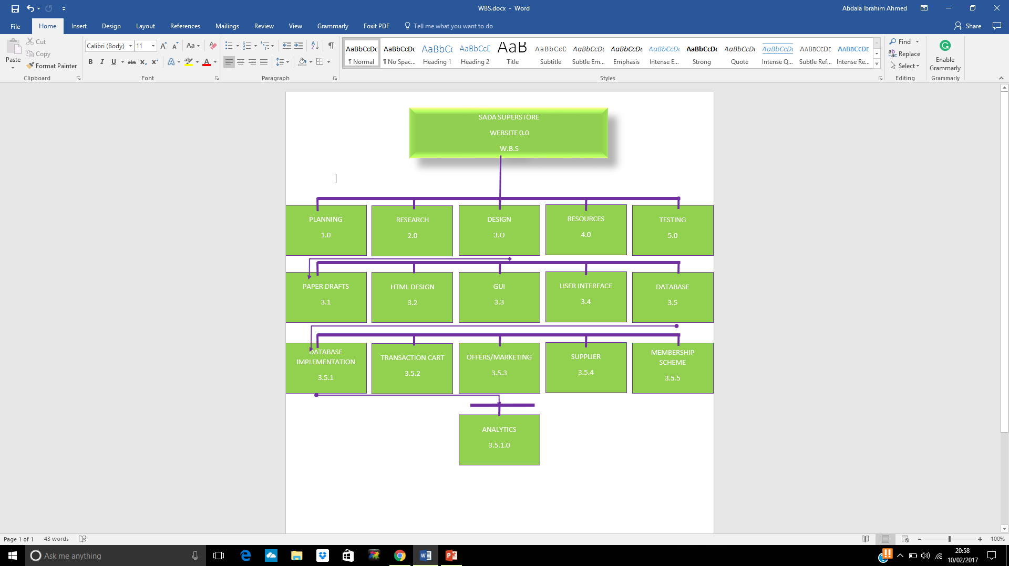
WBS (Work Breakdown Structure)

Slide 7
Head Core Developer / Analytics
Head Core Developer
Website Structure
Database Structure
Quality Assurance
The field of data analysis. Analytics often involves studying past historical data to research potential trends, to analyse the effects of certain decisions or events, or to evaluate the performance of a given tool or scenario.
The goal of analytics is to improve the business by gaining knowledge which can be used to make improvements or changes.

Slide 8
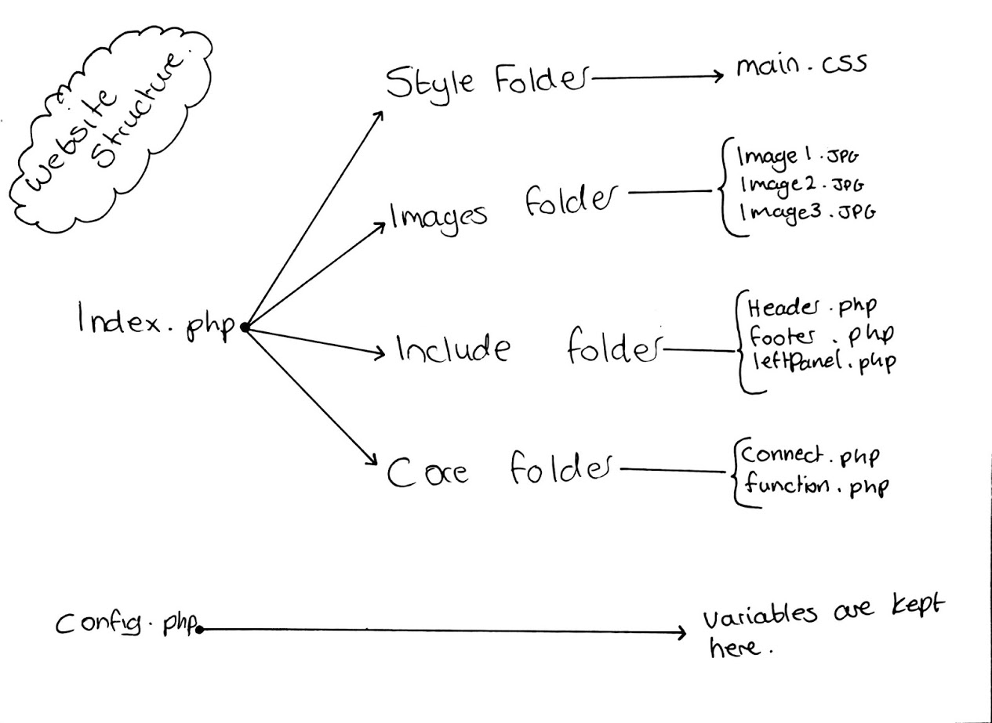

Slide 9
Database
Table names:
Account
Cart
News
Products
Promotions
Purchase_order
Purchase_transactions
Stock
Supplier

Slide 10
Cart
Id User_id Cate Product_name Product_code Quantity S_price F_price Discounted
Supplier
Id Name Address Postcode Number
Account
Id Fname Sname Email Address Postcode Number Password Account_type Balance Points
News
Id Title Content Date Banner Account
Stock
Id Product_id Product_type Product_name Product_quantity supplier
Products
Id Name Cate Code Image Price
Purchase_transactions
Id Purchase_id Product_id Product_name S_price quantity
Purchase_order
Id User_id Price Date
Promotions
Id Desc Code Discount Cate

Slide 11
Project Manager
Overall responsibility for initiating, planning, design, execution, monitoring, controlling and finalising the project
The ability to ask penetrating questions
Chase up and confirm assumptions
Key roles – planning and setting up variables
Resourcing
Schedules
Managing issues
Leadership
Confidence and assurance

Slide 12
Supplier
Who is a supplier?
Manufacturer, distributor or a vendor
Can ship products to the supplier distribution hubs or directly to the retail store
Reliable and efficient
What is the role of a supplier?
Provide the products
Resellers
The relationship between supplier and seller?
Is a very close relationship almost like a food chain between customer, seller and supplier
Responsibilities of a supplier?
Source the seller good products, material and supplier
What is EDI?
Electronic data integration – links databases, allows access between computer systems.
EDI is the best method and shows the trust between the supplier and seller

Slide 13
Marketing
Marketing is where a business creates new ways in which it can improve the performance of sales in hopes of increasing profit.
A business can do this by tracking consumer purchase, and by doing so can offer promotions and offers on popular products.
I approached this core by first researching the offers and promotions of other companies such as Tesco and Sainsbury for a better insight.
In doing so it has helped in deciding on offers and promotions that we will integrate into the software.

Slide 14
Marketing-Software
[The code will be here along with a screenshot displaying its function and purpose and how it affects the software.]

Slide 15
Loyalty Scheme
Loyalty Scheme

Slide 16
Payment

Slide 17
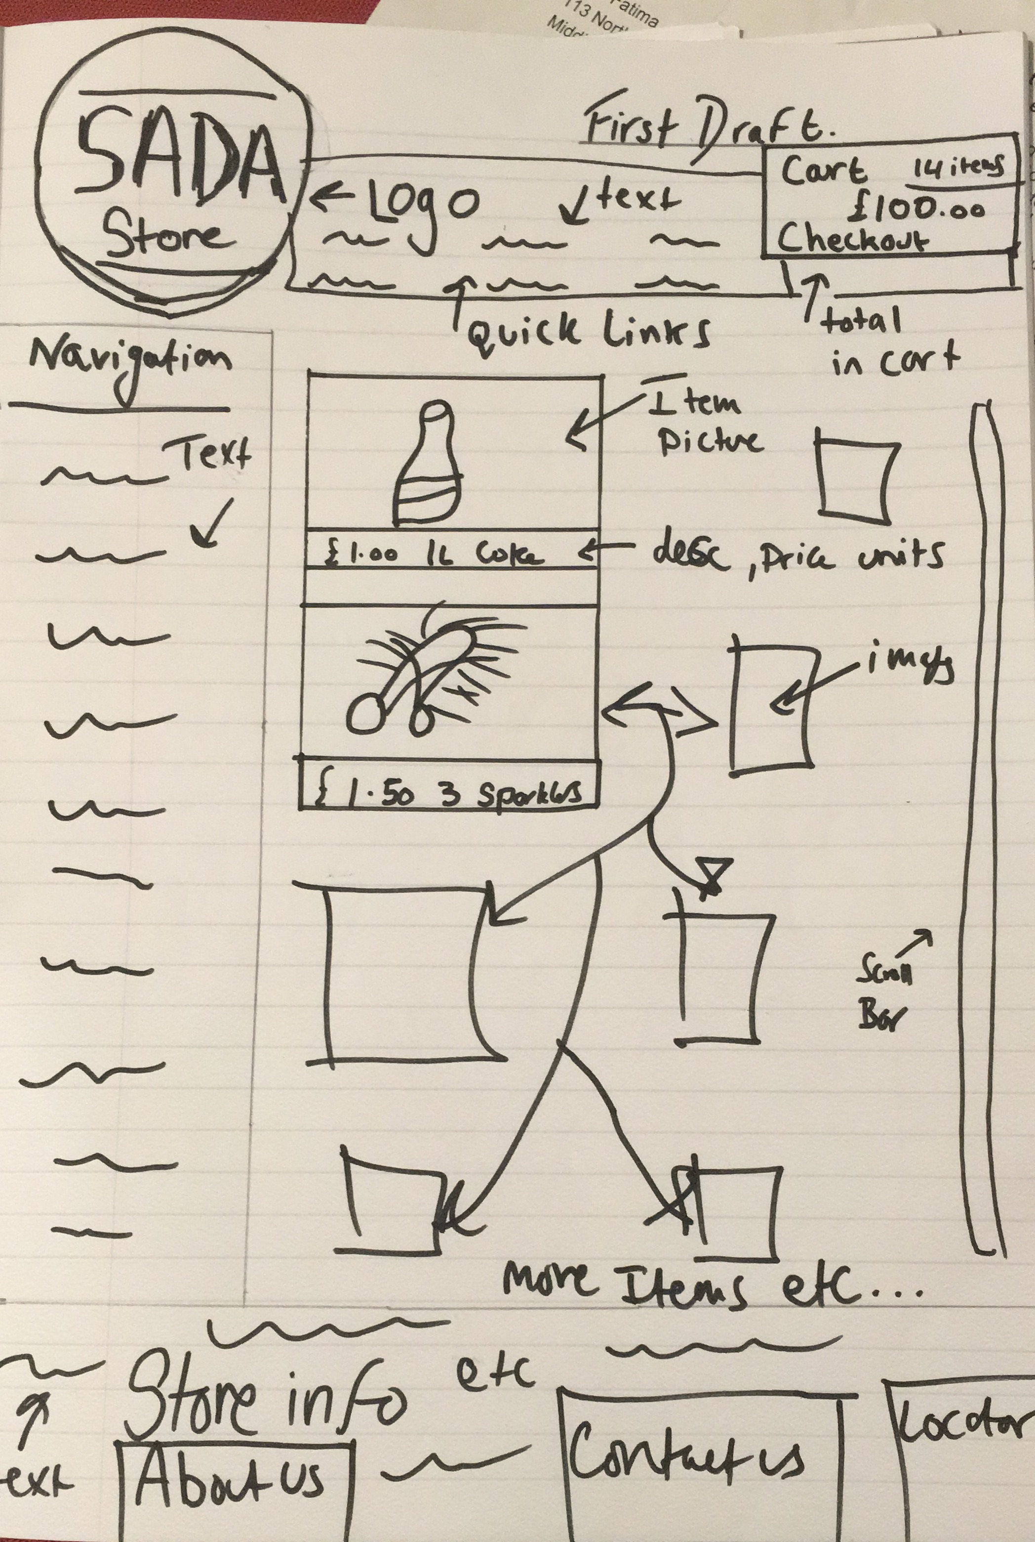
First Design

Slide 18
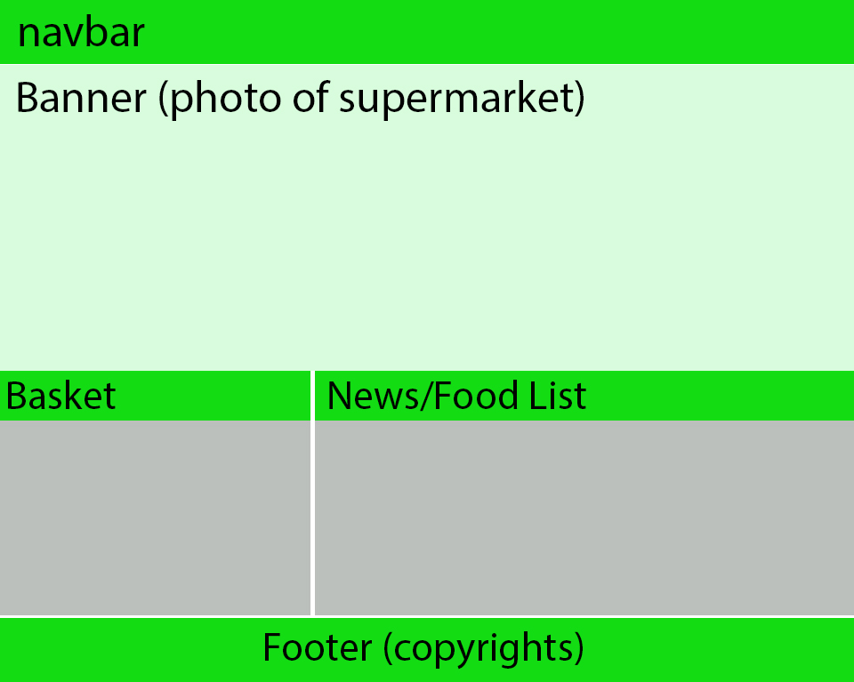
Draft Design

Slide 19
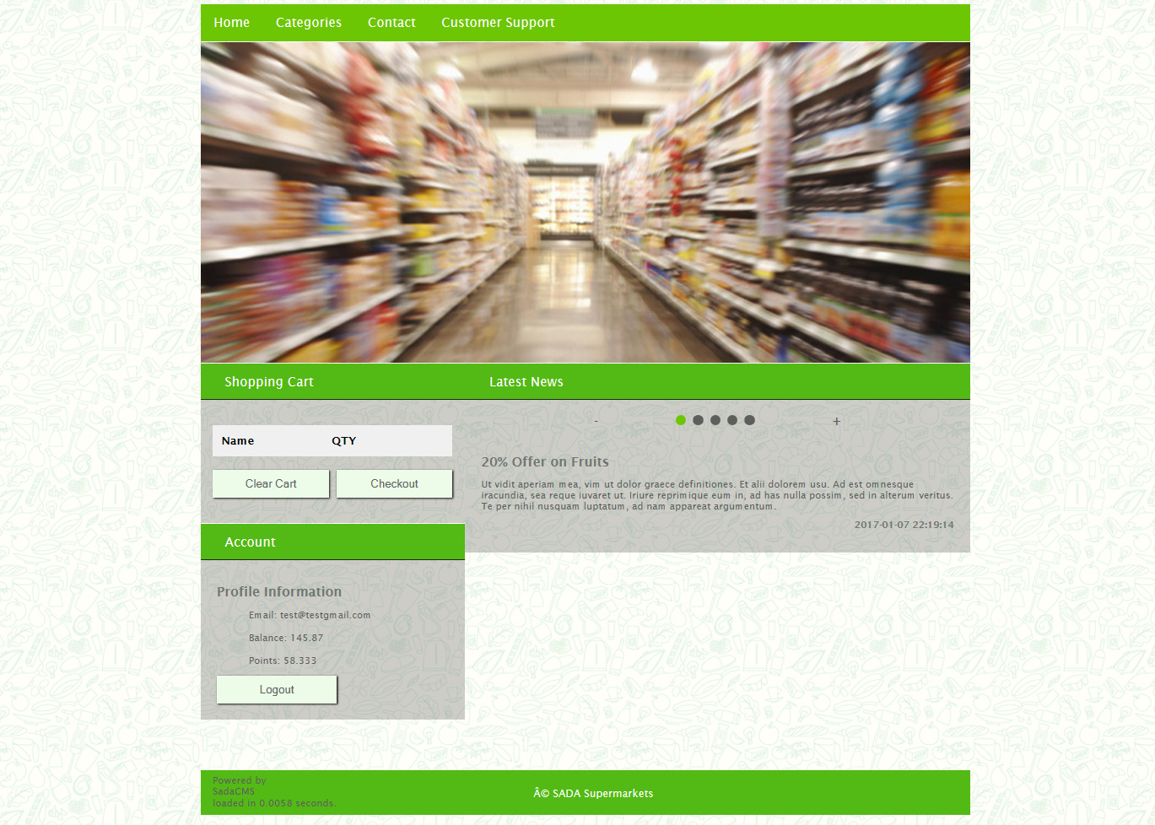

Slide 20
Thank you for your time
Any Questions?

